Slide 1
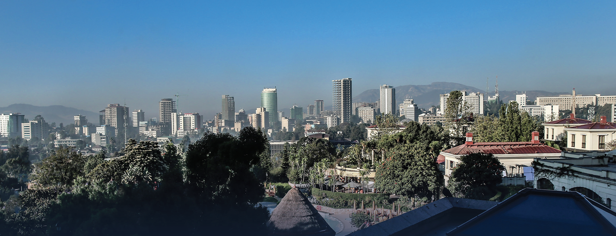

Ethiopia: A New Horizon of Hope

Slide 2
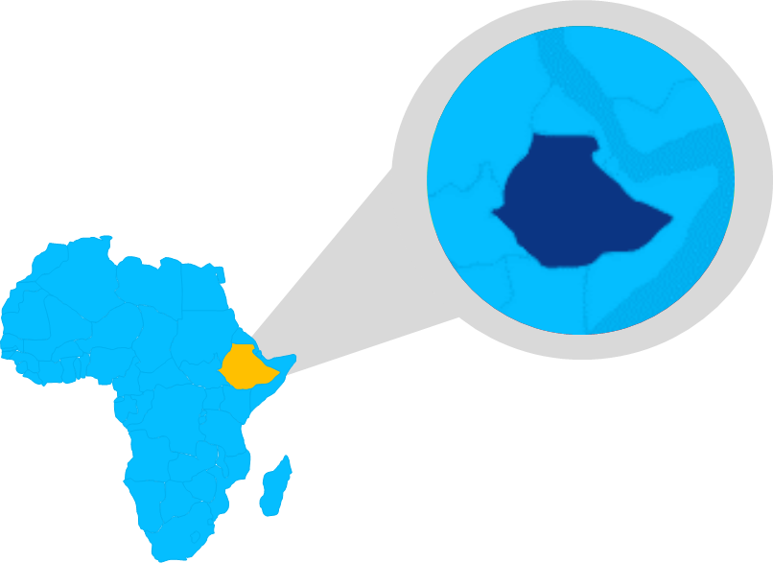
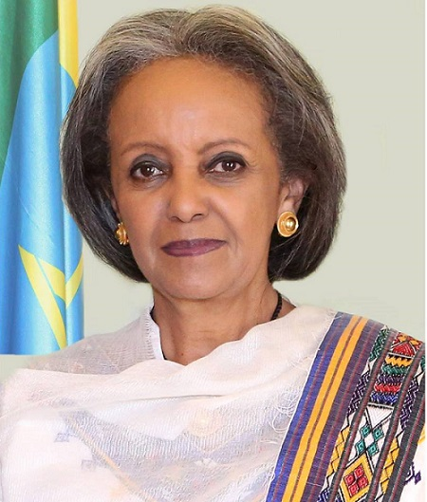
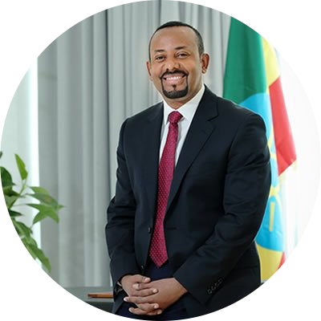

Ethiopia at a glance
Governance structure
Federal government structure
9 semi-autonomous regions; 2 chartered cities
Parliamentary system
  President: Sehale-Work Zewde
  Head of State
  Prime Minister: Dr Abiy Ahmed
  Head of Government
Official Name
Federal Democratic Republic of Ethiopia
Economics
GDP- 84.35 USD Bn
GDP growth rate: 10%
Location
Horn of Africa, at the crossroads between Africa, the Middle East and Asia
Demographics
Population: ~105 Mn (2017), second most populous country in Africa
Population growth (annual %)- 2.5%
Life expectancy- 65 years
Area
1.1 million square kilometers
Notes:
“Stellar FDI performance” (World Bank)
Led by investment in manufacturing sector
Top 3 FDI destination in Africa (UNCTAD 2017)
2nd largest recipient of FDI in the apparel & textile industry (UNCTAD 2017)

Slide 3
Ethiopia’s economy has registered double digit economic growth successively for over a decade and half asserting itself as one of the world’s fastest growing economy
Notes:
“Stellar FDI performance” (World Bank)
Led by investment in manufacturing sector
Top 3 FDI destination in Africa (UNCTAD 2017)
2nd largest recipient of FDI in the apparel & textile industry (UNCTAD 2017)

Slide 4

Four folds increase in FDI flow has been registered over the last 5 years (from a little over 1 billion USD to more than 4.2 billion USD)
Total FDI inflow & share of manufacturing FDI 2006/07 - 2016/17 (in USD million)
Source: Ethiopian Investment Commission: National Bank of Ethiopia, USAID - Ethiopia Performance Monitoring and Evaluation Service (EPMES) 2017
Notes:
“Stellar FDI performance” (World Bank)
Led by investment in manufacturing sector
Top 3 FDI destination in Africa (UNCTAD 2017)
2nd largest recipient of FDI in the apparel & textile industry (UNCTAD 2017)

Slide 5







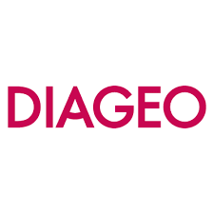














As one of the largest recipient of FDI in Africa, Ethiopia has attracted several global brands highlighting competitive investment opportunities
So what efforts is the country taking to sustain this momentum?
Notes:
“Stellar FDI performance” (World Bank)
Led by investment in manufacturing sector
Top 3 FDI destination in Africa (UNCTAD 2017)
2nd largest recipient of FDI in the apparel & textile industry (UNCTAD 2017)

Slide 6
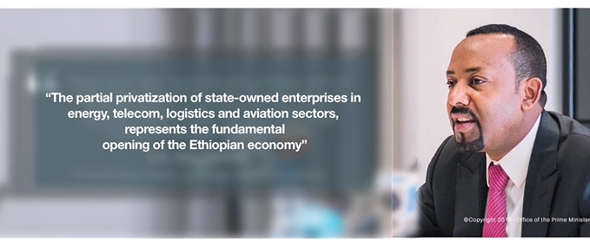
Ethiopia has undergone significant changes over the last year; opening up of the economy is currently underway

Slide 7



Several reforms underway to create a predictable, transparent and efficient regulatory framework
  National initiative to improve Ethiopia’s ease of doing business launched by PM Dr. Abiy Ahmed
  More than 80 reforms, vision to place Ethiopia amongst the top 100 countries on WB’s Ease of Doing Report
  Efficient, transparent, predictable and modern investment regulatory and administrative framework
  Further open up investment areas to private sector
Doing Business reforms
Investment legal reform
  Forging an enabling environment to create a productive and competitive private sector that creates jobs for the youth and lower youth unemployment
  Signature to AfCFTA, which unlocks market access potential of 1.2 billion people
Investment and Job Steering Committee
Regional economic integration

Slide 8
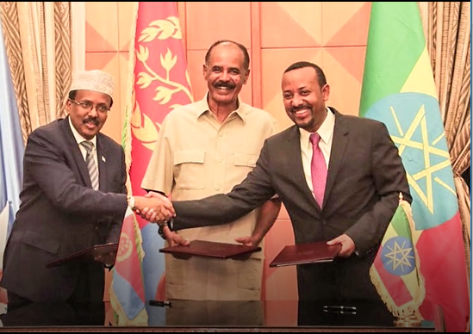
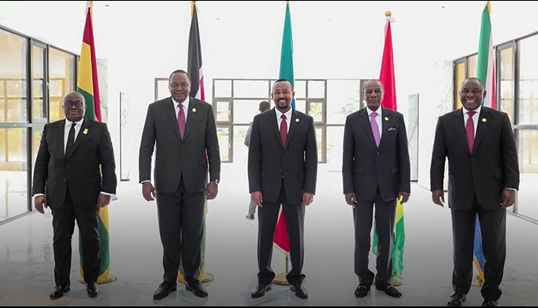
The country has also taken leadership in building a positive political landscape in the region

Slide 9

The country has set the vision to become the leading manufacturing hub of Africa and a preferred destination for FDI by 2025
KEY GOVERNMENT STRATEGIES TO ATTAIN VISION
1
  Targeted investment in priority areas
2
  Development of world-class industrial parks fitted with sustainable infrastructure
3
  Tailored incentives
4
  Conducive enabling environment
DEEP DIVE FOLLOWS

Slide 10
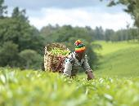


1
Strategic priority areas have been identified for FDI attraction and export promotion
Agro-processing
Land size and climate: 8th largest in Africa and 27th in the world; large arable land, diverse topography and agro-climatic zones, a long growing season, fertile soils and water availability for irrigation
Birthplace of coffee: Regional leading producer and exporter of coffee Arabica and 5th in the world)
Livestock: Regional lead and among top 10 in the world- immense potential in meat processing and dairy sector
Continental lead in honey and beeswax production
Variety of different sesame seeds which are highly valued on the international market. Production of sesame in the country has doubled in the past five years.
Horticulture
Flowers: 4th largest non-EU exporter to the EU cut-flower market and the 2nd largest flower exporter from Africa
Fruits and Vegetables: Land able to grow tropical and sub-tropical, temperate fruits, as well as majority of vegetables; Land suitable for organic certification
Herbs and Spices: 122,700 Has being used for spice farming, with spice production reaching 244,000 tons per year (Potential of 200,000 hectares)

Slide 11

1
Strategic priority areas have been identified for FDI attraction and export promotion
Textile and Apparel
Potential to develop a competitive cotton or textiles industry: potential for backward and forward linkage
54 million trainable workforce with competitive wages, cheap electricity
Strategically located with easy access to international value chains with access to a state-of-the-art container port (Djibouti)
Duty-free and quota free access to the European Union (EU) and U.S. markets through the African Growth and Opportunity Act
Investment Opportunities
  Ginning, integrated textile mills, spinning, weaving and/or knitting, dyeing and printing,
  Production of garments; the manufacturing of knitted and crocheted fabrics, carpets, and sportswear, among others
Leather and leather products
Regional lead in livestock population (9th from the world): +53 million Cattle, 25.5 million Sheep and 24.1 million Goat population: only 50% of hides and skins potential are being utilized
Potential for price competitive and quality supply of skins and hides: Ethiopia’s highland sheepskins have a worldwide reputation in terms of quality, thickness, flexibility, strength, compact structure, and a clean inner surface.
Investment Opportunities
  Tanning of hides and skins up to finished level;
  Manufacturing of luggage (such as handbags), saddle and harness items, footwear, and garments; and
  Integrated tanning and manufacturing activities.

Slide 12
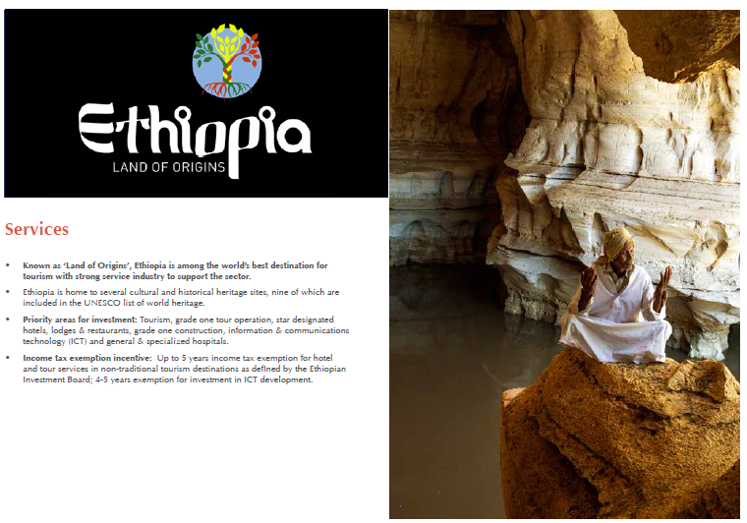



1
Strategic priority areas have been identified for FDI attraction and export promotion
Tourism
Located in the horn of Africa’s rift valley region and best known worldwide for being the origin of mankind and one of the oldest civilizations
Home to several cultural and historical heritage sites, nine of which are included in the UNESCO list of world heritage.
In addition, Addis Ababa’s significance as the political capital of Africa brings high representation of international and regional organizations, including the seat of the African Union and the United Nations Economic Commission for Africa.
ICT
Identified as strategic priorities by the Government of Ethiopia as it will drive and facilitate the transformation of Ethiopia's predominantly subsistence-agriculture economy to into an information and knowledge-based economy and society, that is effectively integrated into the global economy.
Tailored industrial park has been dedicated to the sector

Slide 13
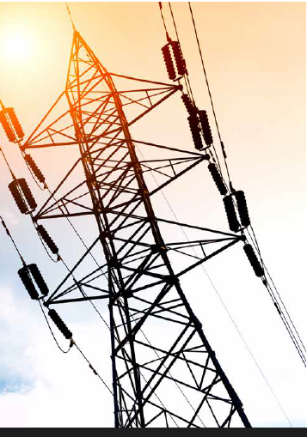

1
Strategic priority areas have been identified for FDI attraction and export promotion
Energy
Rapidly growing electricity demand at 30-35% annually; Growing population, 13+ industrial parks requiring more than 1700 MW of electricity, electric powered national railway requiring over 4,500 KM, plans of exporting power to Kenya, Tanzania, Sudan and Djibouti
More than 80 GW of exploitable renewable energy reserves;
    45 GW of Hydro power exploitable energy reserves, >80% is unexploited;
    7 GW of Geothermal exploitable energy reserves, >86% is unexploited; and
    An average of 5.5 kwh/m2/day of Solar energy capability, >98% is unexploited
Low electricity access provides opportunity for off-grid solutions; Over 95% of rural areas and over 14.3 million households are without the access to power.
Mining
Ethiopia has a wide variety of untapped mineral resources and offers opportunities in upstream and downstream operations.
Ethiopia is the only producer of opal in Africa, major gold exporter, and emerging country for oil and natural gas exploration.
Mining potentials: gold, potash, platinum, opal, iron, tantalum, marble, granite, limestone etc

Slide 14


1
Strategic priority areas have been identified for FDI attraction and export promotion
Pharmaceuticals
Growing local market: Ethiopia’s pharmaceutical market is expected to grow by 15% annually and reach $ 1 billion by 2020
Accessible local and regional market: Ethiopia has the potential to serve as an export hub for the > $ 20 billion pharmaceutical markets in Africa
Trainable workforce with competitive wages
More than 10 schools of pharmacy in Ethiopia are planning to expand with sector specialization programs
Availability of tailored investment incentive schemes towards the pharmaceutical sector and industrial park development
A big demand and supply gap for pharmaceutical products, with only a few local manufacturers covering < 20% of the demand

Slide 15
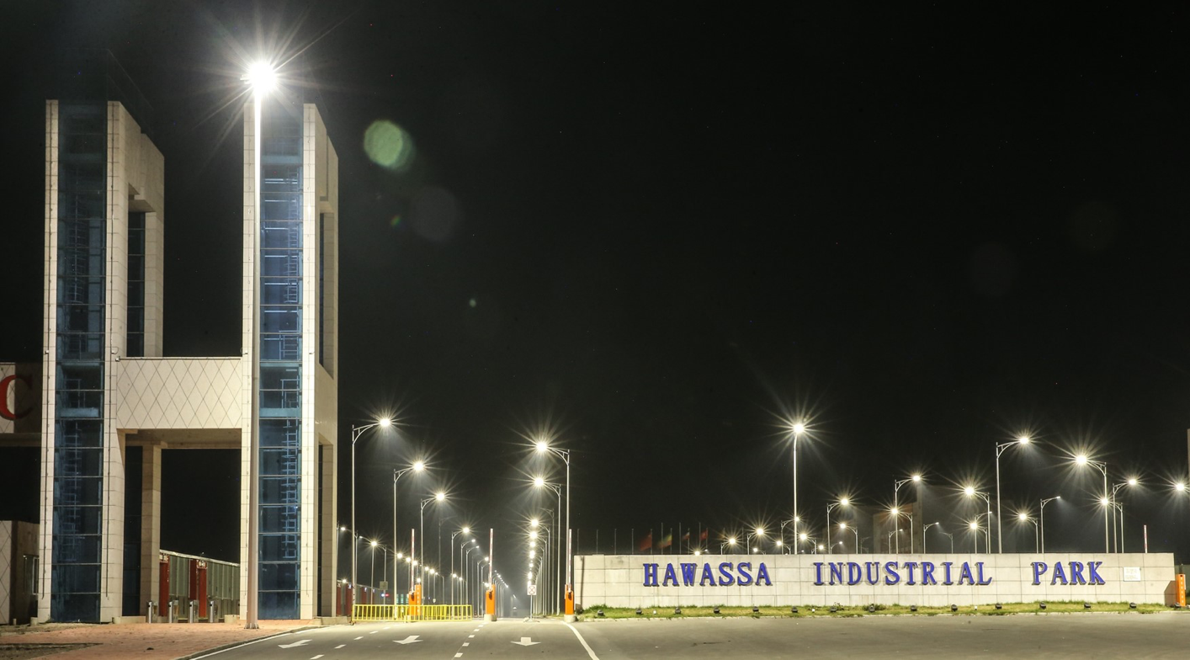
2
Several plug-and-play Industrial Parks are being developed through out the country
Industrial Parks:
Catalyst to drive Ethiopia’s industrialization agenda

Slide 16
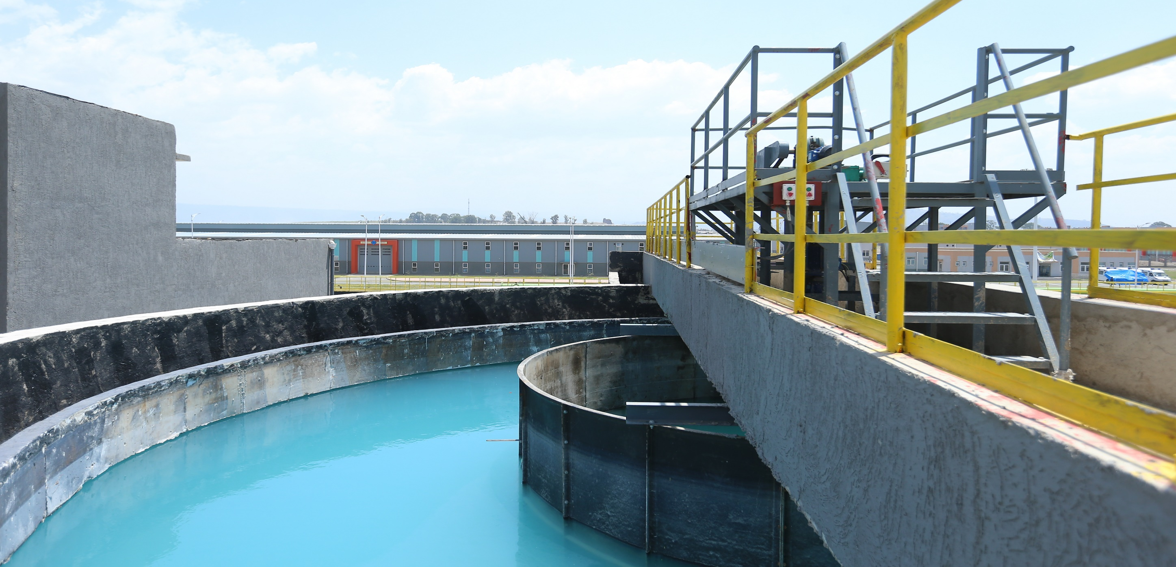
2
Sustainability is integral element of the parks
Africa’s 1st park with zero liquid discharge facility (ZLD)

Slide 17
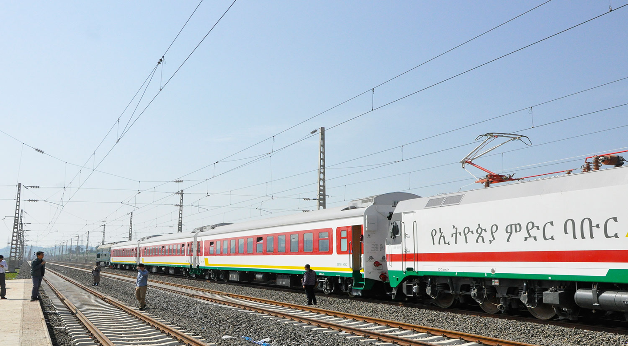
  Development of world-class industrial parks fitted with sustainable infrastructure
2
Massive investment has also been made in infrastructure development in support of industry (1/3)
Electric-powered Railway
to ease logistics
Africa’s 1st electric-powered railway

Slide 18

2
Massive investment has also been made in infrastructure development in support of industry (2/3)
Ethiopian Airlines – Cargo hub
Largest cargo network and terminal in Africa

Slide 19
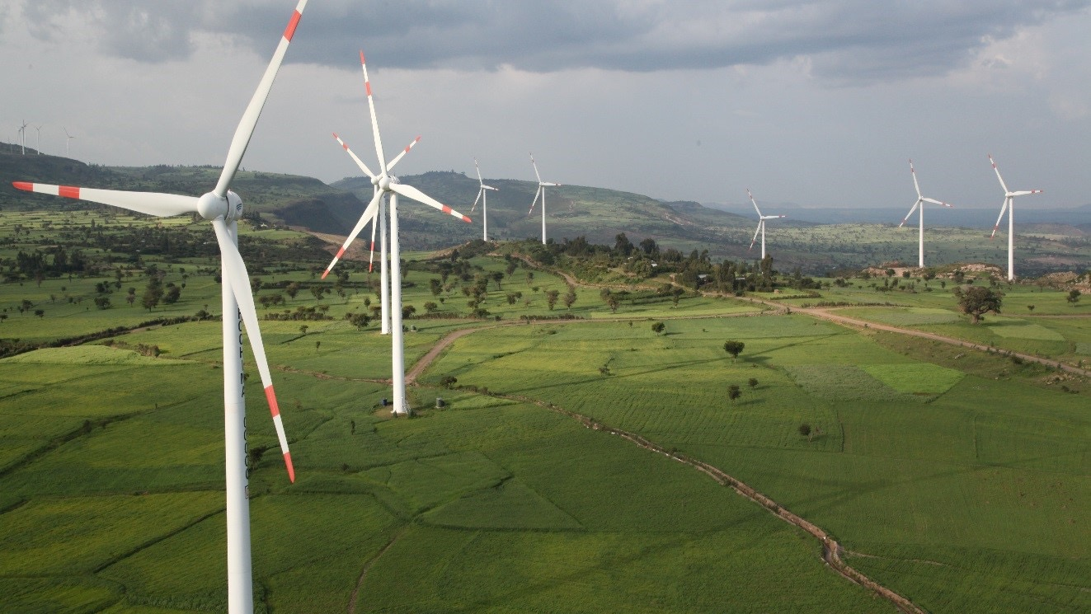
  Development of world-class industrial parks fitted with sustainable infrastructure
2
Massive investment has also been made in infrastructure development in support of industry (3/3)
cost-competitive, renewable and clean energy
Green electricity generation supports industrialization

Slide 20



  Tailored and competitive incentives
3
Tailored and competitive incentives are provided to foreign investors
FISCAL
NON-FISCAL
OTHER
Income Tax exemptions
Custom tax exemptions
Loss carry forward
Full export duty exemption
Guarantee against expropriation
Guarantee for repatriation of funds
Customs facilitation through bonded export factory and similar other schemes
Relaxed Industrial park land regime
One-Stop Shop Service
Expedited procedure for securing visa, work permit and certificate of residency
Facilitation of market linkages

Slide 21


